Slide 1
Cancer Biology Biol 445
Spring 2020
Dr. Heidi Super
Lecture 10
2-10-2020

Slide 2
Field trip!
I have arranged to visit Dr. Badie Alakech—a pathologist at Trinity Hospital.
February 19th
Plan to arrive by 11 am and stay until at least 11:50.
I will figure out our best meeting place and can drive up to 4 students there.
I will try to help us prepare some for the experience.

Slide 3
Where were we?
DNA repair
Defective repair is an indirect factor in development of cancer.
Defective repair increases the likelihood that any cell will acquire a sufficient number of mutations in genes controlling cell division, or apoptosis, or other processes that affect the accumulation of cells.

Slide 4
Several DNA repair genes…
Discovered by:
Noting early onset cancer in families
Abnormally high rate of specific types of cancer
BRCA 1 BRCA2 associated with breast, ovarian, and recently prostate cancer
Xeroderma Pigmentosum---Extreme sensitivity to sun, early onset and many skin cancers

Slide 5
XP-associated genes
XP is associated with mutations in one or more of least 8 different genes encoding proteins involved in nucleotide excision repair (NER)
https://ghr.nlm.nih.gov/condition/xeroderma-pigmentosum#genes

Slide 7
What did you learn about HNPCC? (also known as Lynch syndrome)
Which repair system is faulty?
Did you read about any of the specific genes involved?
Also more in chpt. 10 p. 187-188
https://ghr.nlm.nih.gov/condition/lynch-syndrome#genes

Slide 8
So…cancer is a genetic disease
Distinguish between:
Inherited genetic abnormalities associated with cancer.
AND
2. Acquired genetic abnormalities associated with cancer.

Slide 9
Gene table?
Maybe add 2 or 3 rows for different types of DNA repair genes?
Type of repair | Examples of genes | Type of cancer | Increased risk | Why?
DS break repair
NER
Mismatch repair

Slide 10
Genetic testing
Whether the cancer-associated mutations are found only in the cancer cells (acquired somatic mutations) or in all cells of the individual (inherited germline mutations), the identification of the the altered gene(s) requires DNA analysis/DNA sequencing.
We will return to how this is done soon…

Slide 11
Chapter 3--angiogenesis
Thus far our focus has been on the cancer cell and the mechanism by which a cell can lose control of division.
Cancer cells and even tumors are relatively harmless in isolation. In fact, tumors are limited in their growth (to a few millimeters) since all cells/tissues need a source of oxygen and nutrients to exceed a certain size.

Slide 12
Cancer/tumor progression requires establishment of a vascular system---delivery of oxygen and nutrients via the blood.
Establishment of new blood vessels= angiogenesis

Slide 13
Blood vessels are made from endothelial cells
First step in tumor angiogenesis is proliferation and of endothelial cells—endothelial cells lining existing blood vessels.
3-1

Slide 14
It was once hypothesized that the growth of new blood vessels to feed tumors was the result of an immune response.
Studies of solid tumors in their original location shows many similarities to a wound healing sight.

Slide 15
Several scientists, including Judah Folkman, made important discoveries that tumor cells secrete growth factors which activate nearby blood vessels to begin angiogenesis.
Fig 3-2
Folkman’s research identified a new class of growth factors associated specifically with angiogenesis.

Slide 16
Vascular Endothelial Growth Factor
VEGF is among the most important of the angiogenic factors.
Endothelial cells express VEGF receptors.
Binding of VEGF starts a signal transduction cascade which induces the production and secretion of a new type of protein called matrix metalloproteinases (MMPs) by the endothelial cells.

Slide 17
Several other angiogenic factors
Epidermal Growth Factor (EGF)
Fibroblast Growth Factor (FGF)
Granulocyte colony stimulating factor (GCSF)
Interleukins
Tumor Necrosis Factor alpha (TNFα)
Platelet-derived endothelial growth factor (TGFα)

Slide 18
Every growth activity must be tightly regulated
Folkman (and others), also identified naturally occuring anti-angiogenic factors.
Angiostatin
Endostatin
Interferons
Thrombospondin

Slide 19
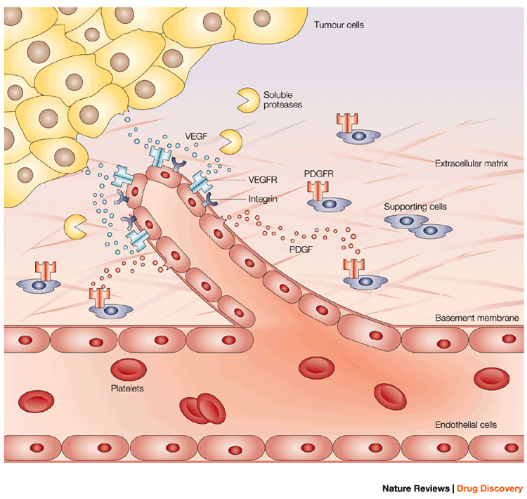

Slide 20
The MMPs simultaneously digest the existing matrix and assist in assembling the endothelial cells into new tubes/blood vessels.

Slide 22
The discovery of anti-angiogenic compounds spurred much excitement and a major push for development of these as therapeutic agents.

Slide 23
Why so much hope?...
The biggest challenge of therapeutic approaches at the time, was making sure every cancer cell was killed. (And tumor cells nearly always develop resistance to single treatments)
The new approach did away with that requirement. Tumor cells could persist, but without a vascular system, could not grow to dangerous size.

Slide 24
Lots of studies in cell lines and in mice
Figure 3-6
Immunocompromised mice injected with human tumor cells—Plus endostatin.
Conclusion…?

Slide 25
2 drugs worked well together in mice…on human tumors

Slide 26
Avastin /Bevacizumab
First FDA-approved anti-angiogenesis drug used in humans (2004) despite failing some phase III (testing on humans/clinical use) drug trials, including a trial for breast cancer.
Has had very limited success….and is mostly limited to very late stage treatments.

Slide 27
Not a first-line drug.
However… the use of this drug is limited to late-stage (patient show metastasis) cancers and only after other other treatments have failed AND is used with other drugs simultaneously.

Slide 28
http://chemocare.com/chemotherapy/drug-info/avastin.aspx
What Avastin Is Used For:
Treatment of metastatic colon or rectal cancer, used as part of a combination chemotherapy regimen.
Treatment for non-squamous, non-small cell lung cancer.
Treatment of metastatic breast cancer used as part of a combination chemotherapy regimen.
Treatment of glioblastoma (GBM). (John McCain’s cancer)
Treatment of metastatic renal cell carcinoma.

Slide 29
One of the first realizations that, while mouse models are generally excellent and closely mimic outcomes in humans, some important differences in mouse and human can impose different outcomes in research and application.
Why?

Slide 30
Many of the human studies were done on late-stage cancer patients. These drugs may work well, before cancer diagnosis.
Drugs were delivered like standard chemo—huge dose, then rest. May require steady-state release.
Maybe we have too many back-up systems that mice do not. Targeting one angiogenesis promoter may not be sufficient.

Slide 31
Understanding drug names
Imantinib----”ib” indicates it is an inhibitor of something. What is it for this drug? You should know!
Bevacizumab---indicates it is a monoclonal antibody. Recall antibody-antigen interactions. These drugs are designed to bind something specfically. In this case, the antigen is VEGF! Bevacizumab/Avastin is an anti-VEGF antibody.

Slide 32
Check this out for current status/progress with antiangiogenic drugs
http://www.cancer.gov/about-cancer/treatment/types/immunotherapy/angiogenesis-inhibitors-fact-sheet

Slide 33
What else does a tumor need?
Your text does not provide much information about supporting cells/tissues beyond blood vessels.
Yet most tumors are a mixture of cancer cells and non-tumor supporting cells---collectively called tumor-associated stroma.

Slide 34
As mentioned earlier, tumor cells secrete a variety of factors---some recruit cells from the host to serve a variety of functions as stroma.
Tumors must establish themselves much like a tissue forming during embryogenesis/fetal development.
Require cells which anchor, shape and protect the actual tumor cells.

Slide 35
Some support/stromal cells are called in from different sights by chemicals which cause migration.
E.g. Chemokines
Macrophages respond to tumor-produced chemokines and migrate to the area much as they do in an immune respose.

Slide 36
Once at the tumor site, stromal cells respond to other tumor-derived chemicals which cause them to organize and/or mature.
E.g. cytokines---special types of growth factors, cause cells surrounding the tumor or newly recruited cells to begin to divide or differentiate.

Slide 37
Chemokine and cytokine signaling is an essential aspect of immune responses too!
(Recall it was thought initially that angiogenesis was due to an immune response).

Slide 38
Tumor microenvironment is very diverse.

Slide 39
We can recognize the non-tumor supporting cells of tumors by staining for cell-specific molecules---immunostaining.
Immunostaining uses antibodies to specific molecules to distinguish different cell types.
The antibody sticks to the cell(s) and has a connected molecule that can be made to fluoresce or to turn color.

Slide 40
The following few slides use a staining technique called Hematoxylin and eosin staining (H and E) of the tissues.
Hematoxylin turns the nuclei purple
Eosin stains various intracellular or extracellular proteins pink
The brown areas are due to a chemical reaction involving a compound bound to a specific antibody. (The technology is immunohistochemistry)

Slide 41
H and E alone

Slide 42
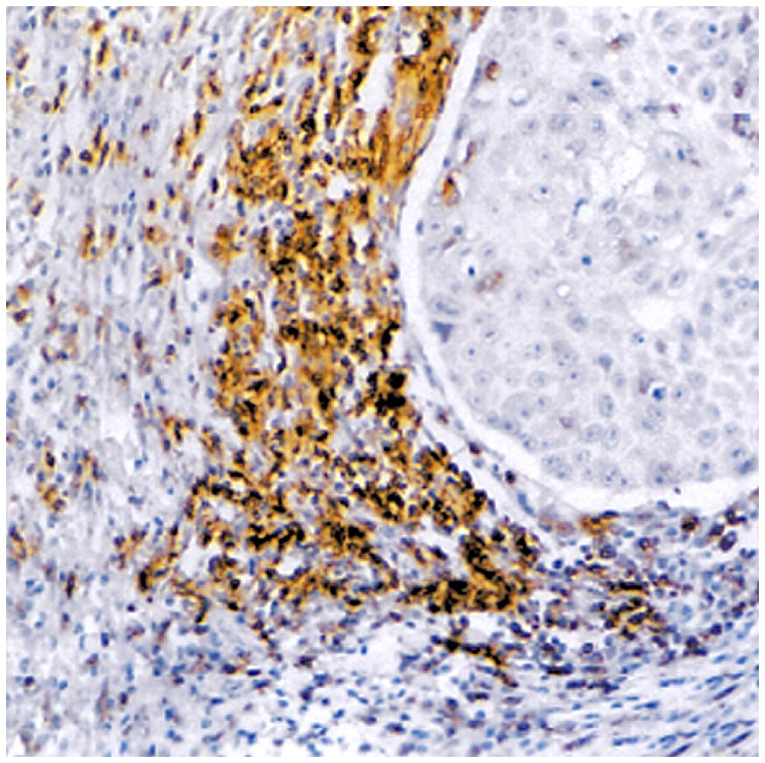
Brown-staining T-cells in a lung carcinoma

Slide 43
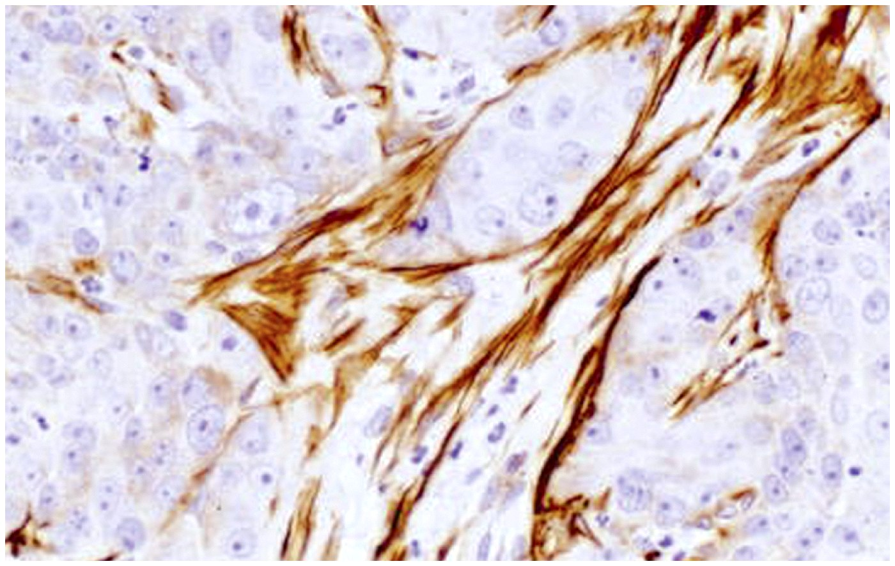
Brown-staining muscle fibers supporting a breast carcinoma

Slide 44
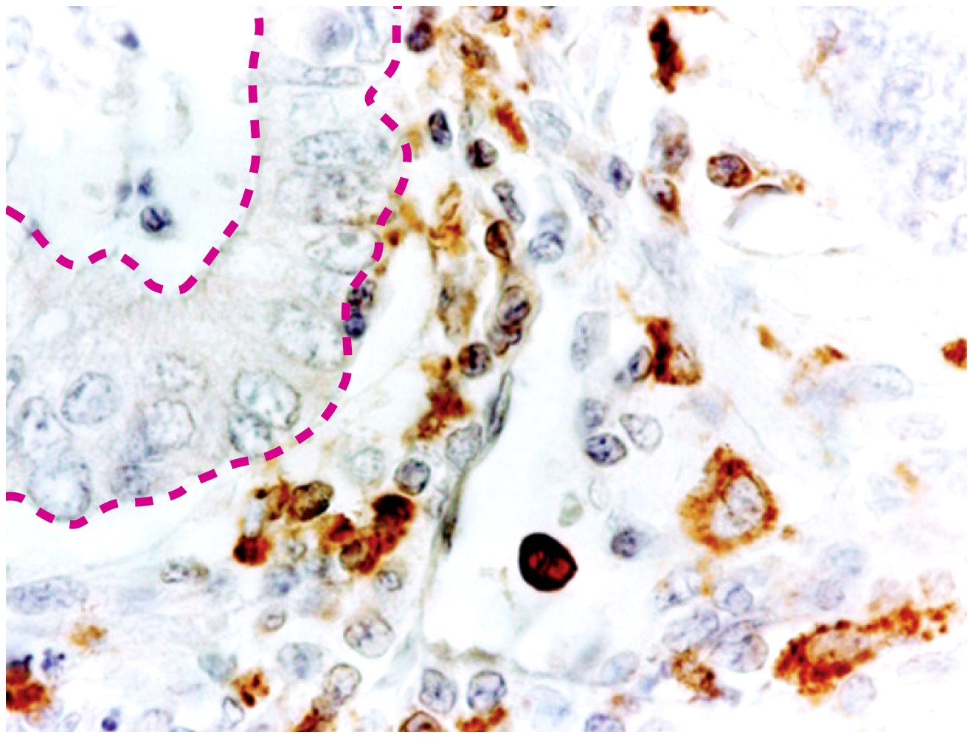
Stromal adipose cells supporting colon adenocarcinoma
Monocytes in the same colon cancer

Slide 45
Recall carcinomas are made of epithelial cells so the stained cells are NOT of tumor origin.
(you would not expect to find cancer-related mutations in stromal cells. )

Slide 46
Tumors are rather heterogeneous at the cellular level.
This has complicated study of solid tumors at times. Biopsy of tumors results in a mix of cells, some of which show cancer-associated DNA changes, most of which are genetically unchanged!

